Slide 1


Genomics and Databases – IMBM5
Cednik Syndrome
Data Analysis for Corpasome family
Presented by:
Tutored by:
Maja Ewen
Melih Gezmen
Flavia Paz
Evan Williams
Roland Krause
Patrick May

Slide 2
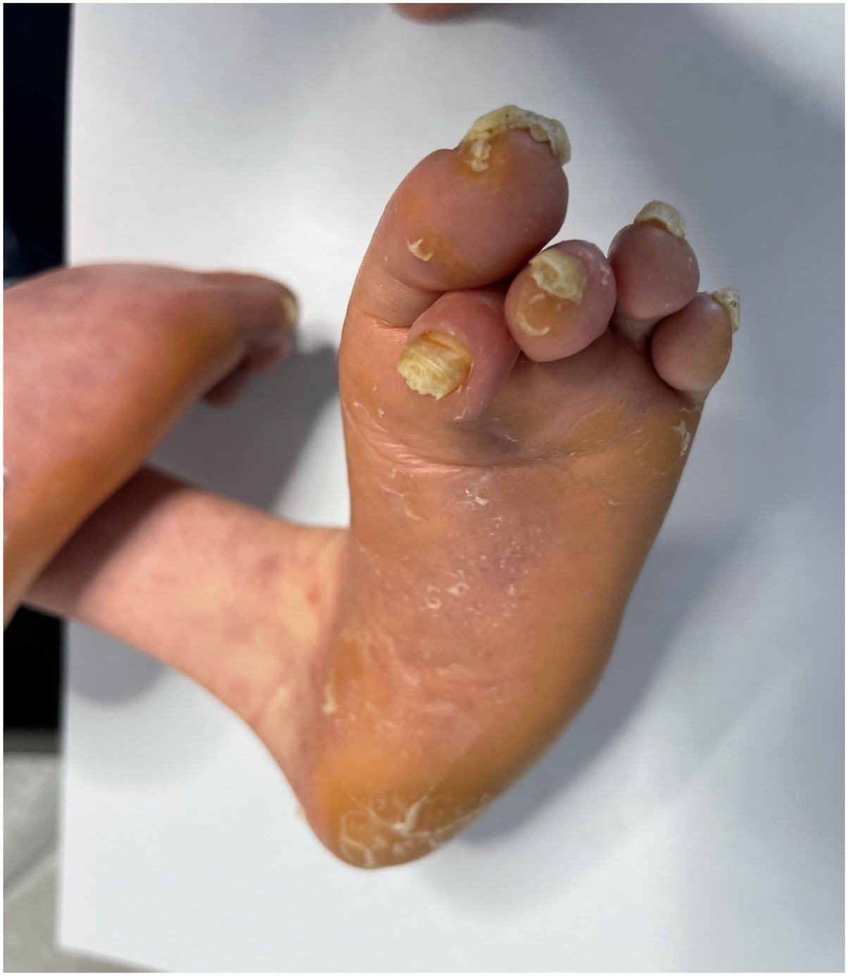
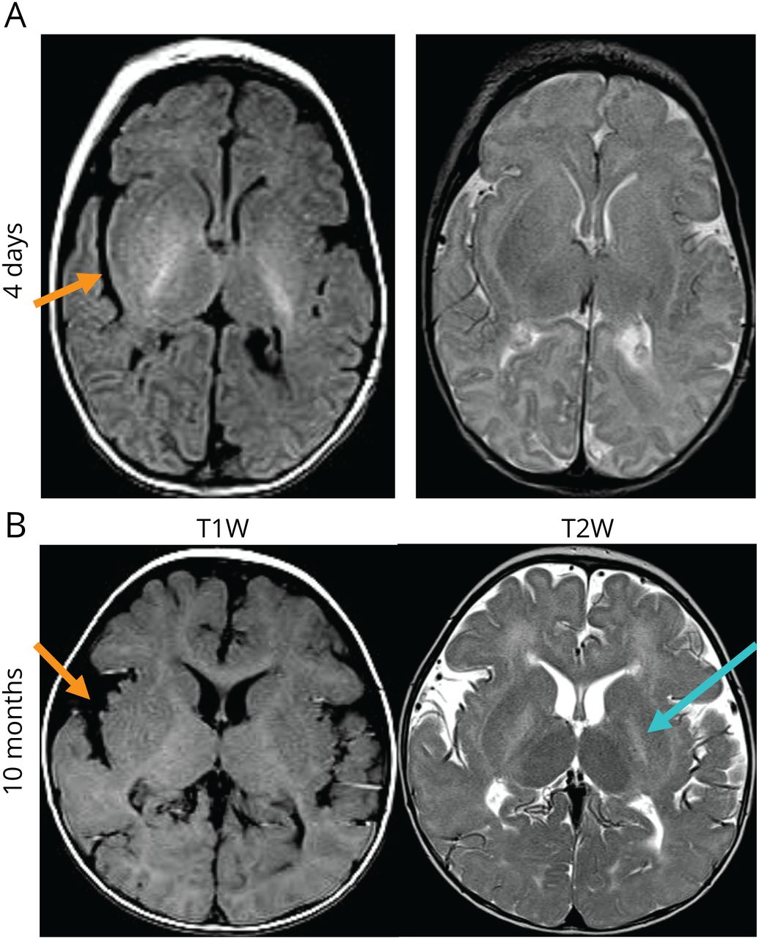
CEDNIK Syndrome
Neurocutaneous syndrome, characterized by cerebral dysgenesis, neuropathy, ichthyosis, and keratoderma, or CEDNIK syndrome (609528) for short, is an autosomal recessive genetic disorder.
Neurocutaneous syndrome, characterized by cerebral dysgenesis, neuropathy, ichthyosis, and keratoderma, or CEDNIK syndrome (609528) for short, is an autosomal recessive genetic disorder.
Figure 1: Skin Keratoderma and ichthyosis
Figure 2: Brain MRI of Patient 1 Shows Corpus Callosum Dysgenesis and Loss of Supratentorial Myelin
Figure 1: Lorenzo-Ríos D, Guerrero-García A, Colón-Fontánez F. Keratoderma and ichthyosis as valuable features for the diagnosis of CEDNIK syndrome JAAD Case Reports, 2023; 46, 64-66
Figure 2: A. Y. Mah-Som et al., "New Cohort of Patients With CEDNIK Syndrome Expands the Phenotypic and Genotypic Spectra," Neurology: Genetics, vol. 7, no. 1, p. e553, Feb. 2021, doi: 10.1212/NXG.0000000000000553.

Slide 3
This disease is caused by a loss-of-function variant in SNAP29 in 22q11.2 region (synaptosomal-associated protein 29), which encodes a SNARE protein, a vesicular membrane fusion protein.

Slide 4
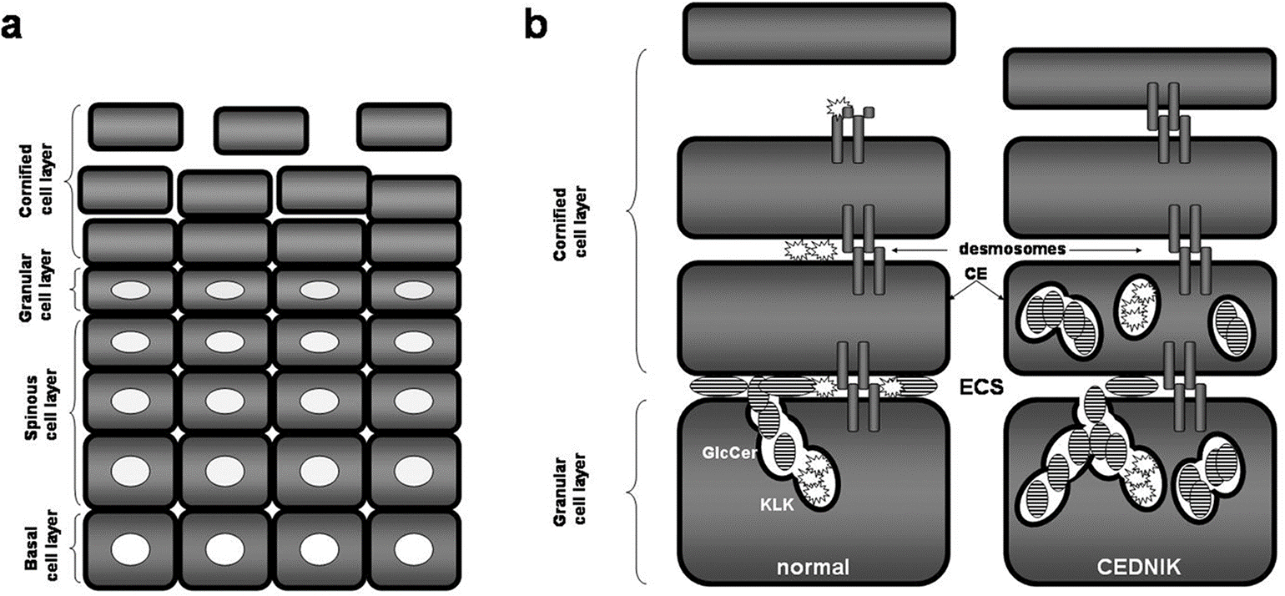
Figure 3. CEDNIK molecular mechanisms of epidermal barrier disruption.
Schiller et al, 2016
https://www.cell.com/cms/10.1086/432556/asset/fa218e55-f090-441e-92c9-984271935749/main.assets/gr6_lrg.jpg

Slide 5
Symptoms
Human Phenotype Ontology | Phenotype
HP: 0000252 | Microcephaly
HP:0001263 | Global developmental delay
HP:0001251 | Ataxia
HP:0008064 | Ichthyosis
HP:0007447 | Diffuse palmoplantar hyperkeratosis

Slide 6
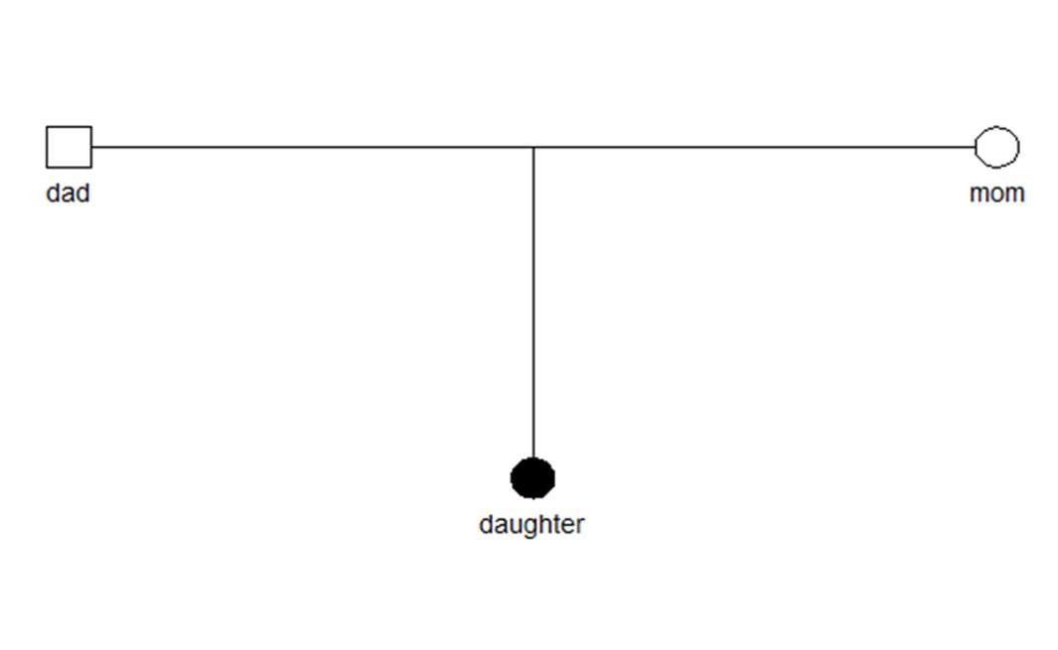
Case
WES – Raw Data
A 3-year-old girl was referred for severe developmental delay and a progressive skin disorder. She has microcephaly, poor motor development and marked delay of all developmental milestones. Neurological examination shows impaired coordination.
During the second year of life she developed generalized ichthyosis and pronounced thickening of the palms and soles. Both parents are clinically healthy.
The Corpas Project
Based on the crowdsourced genomic analysis provided by M. Corpas et al. (2015), we used a trio family case study. For the analysis, the data provide was a Whole-Exome Sequencing (WES) along with specific disease-causing variant positions synthetically introduced for educational purposes.

Slide 7
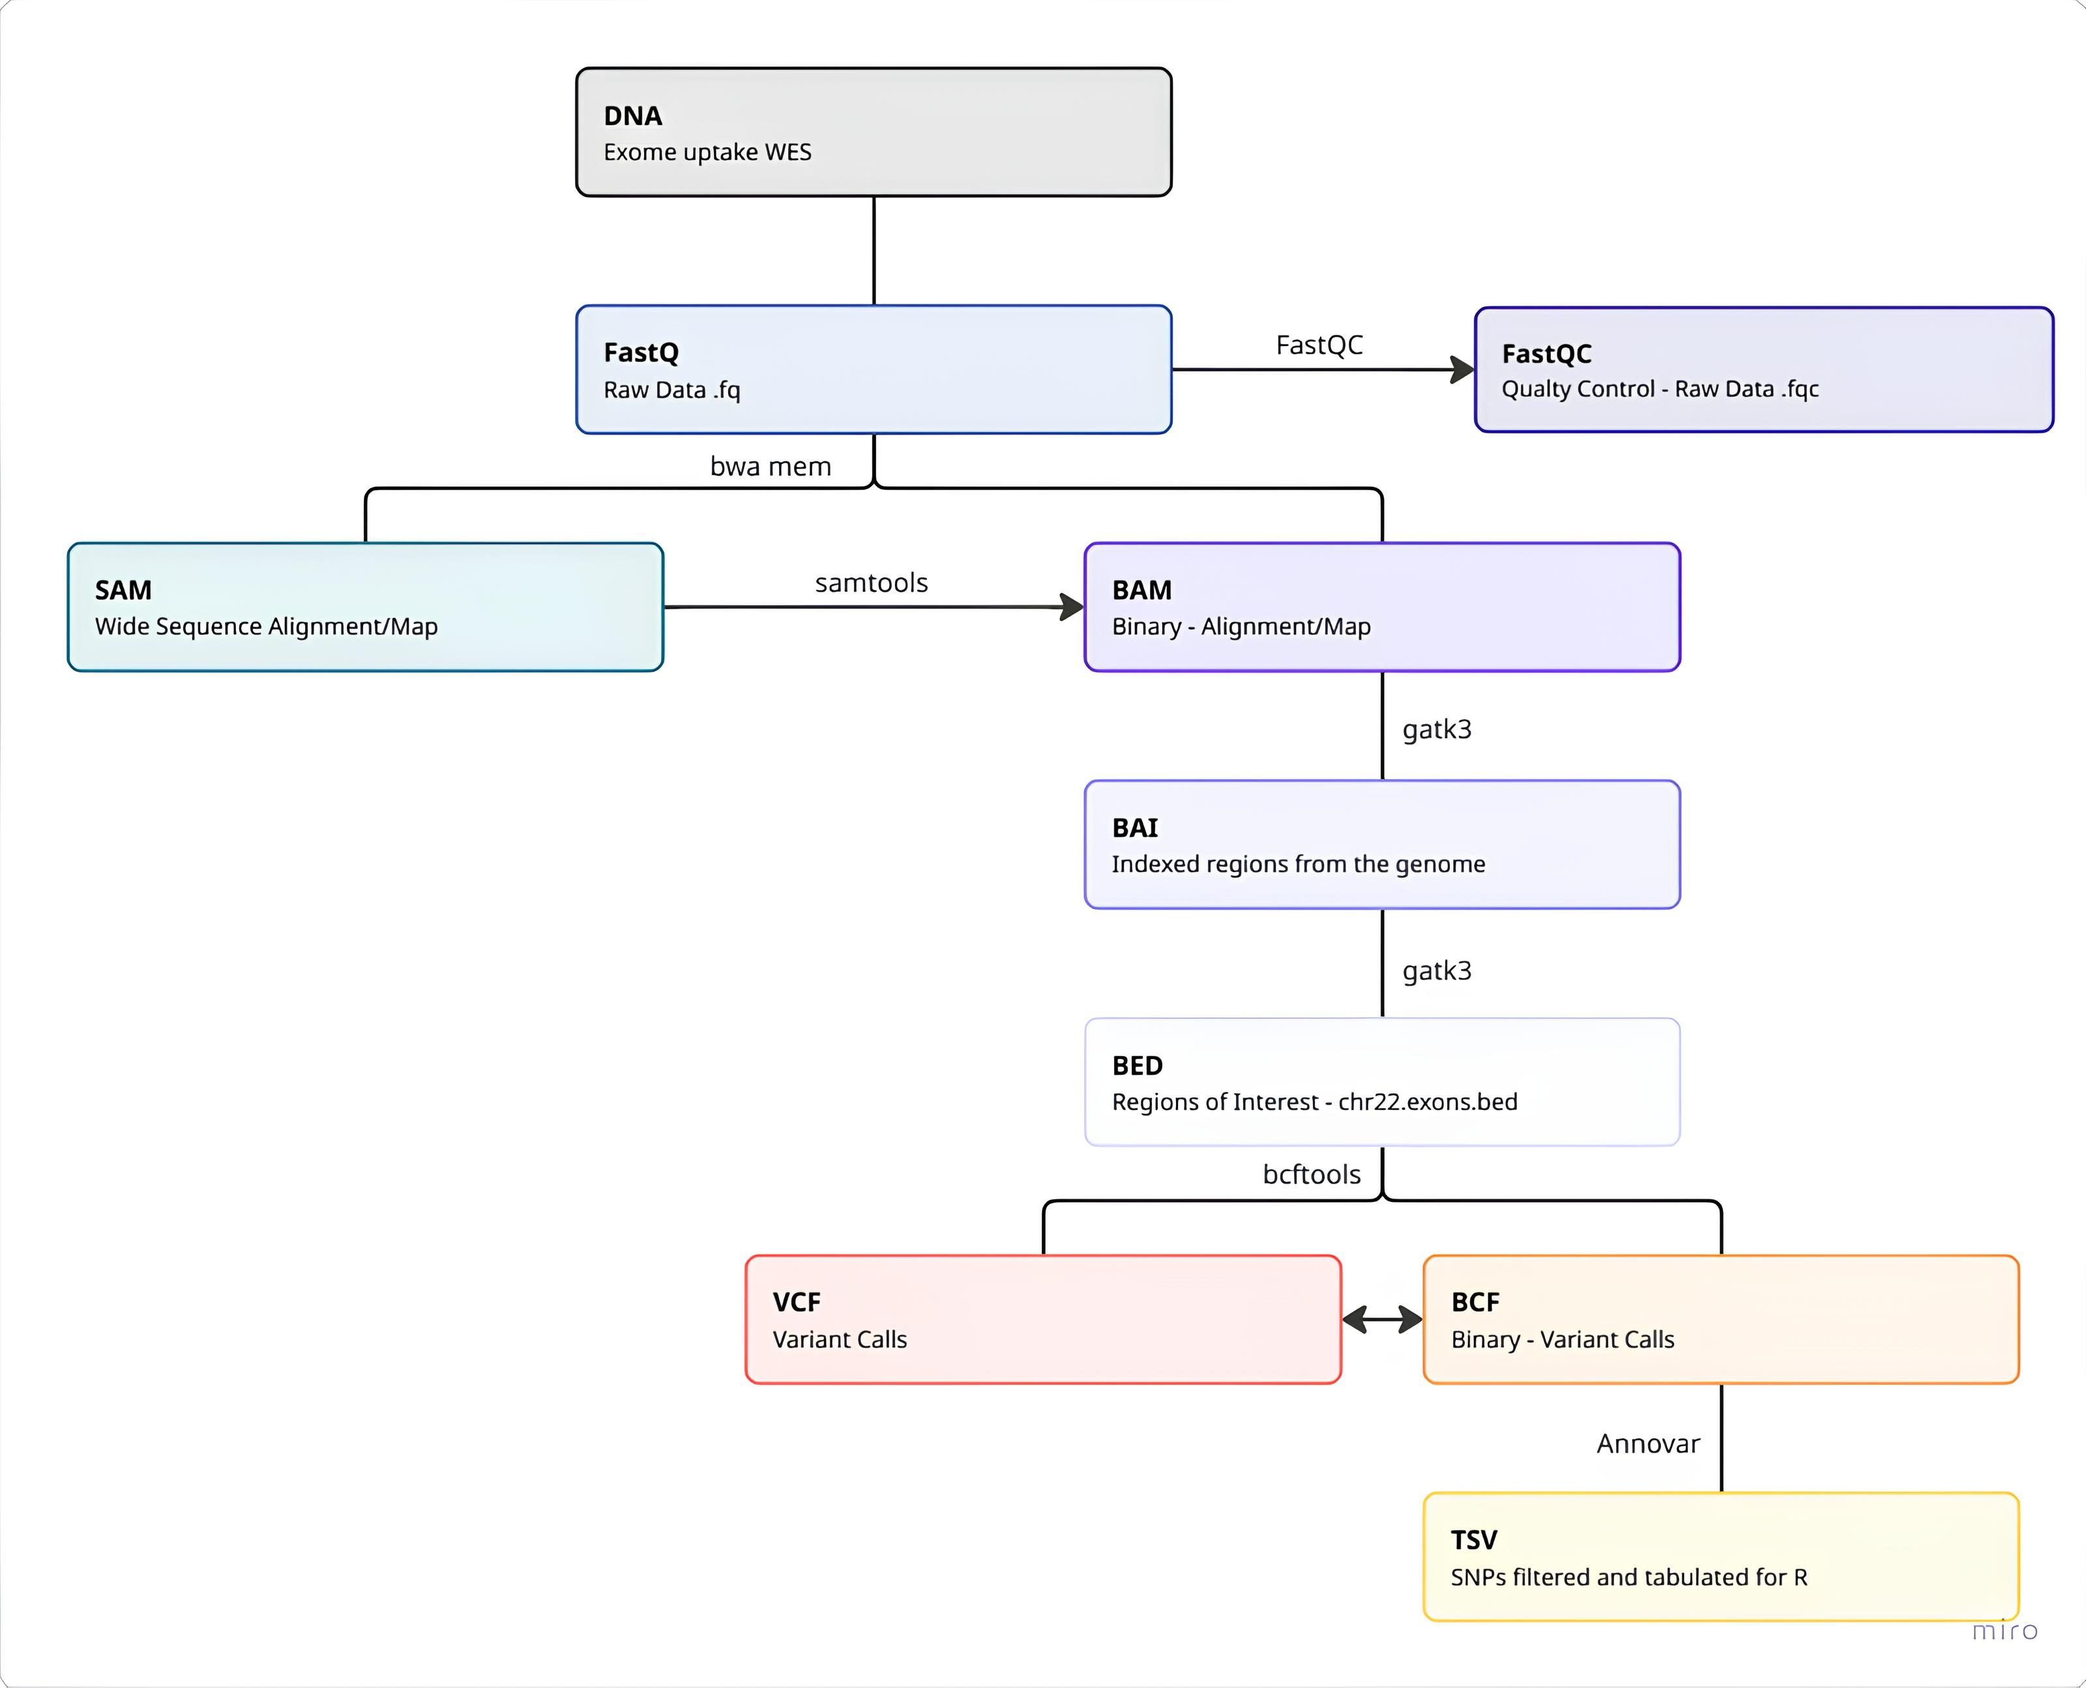
Sample Pre-treatment

Slide 8
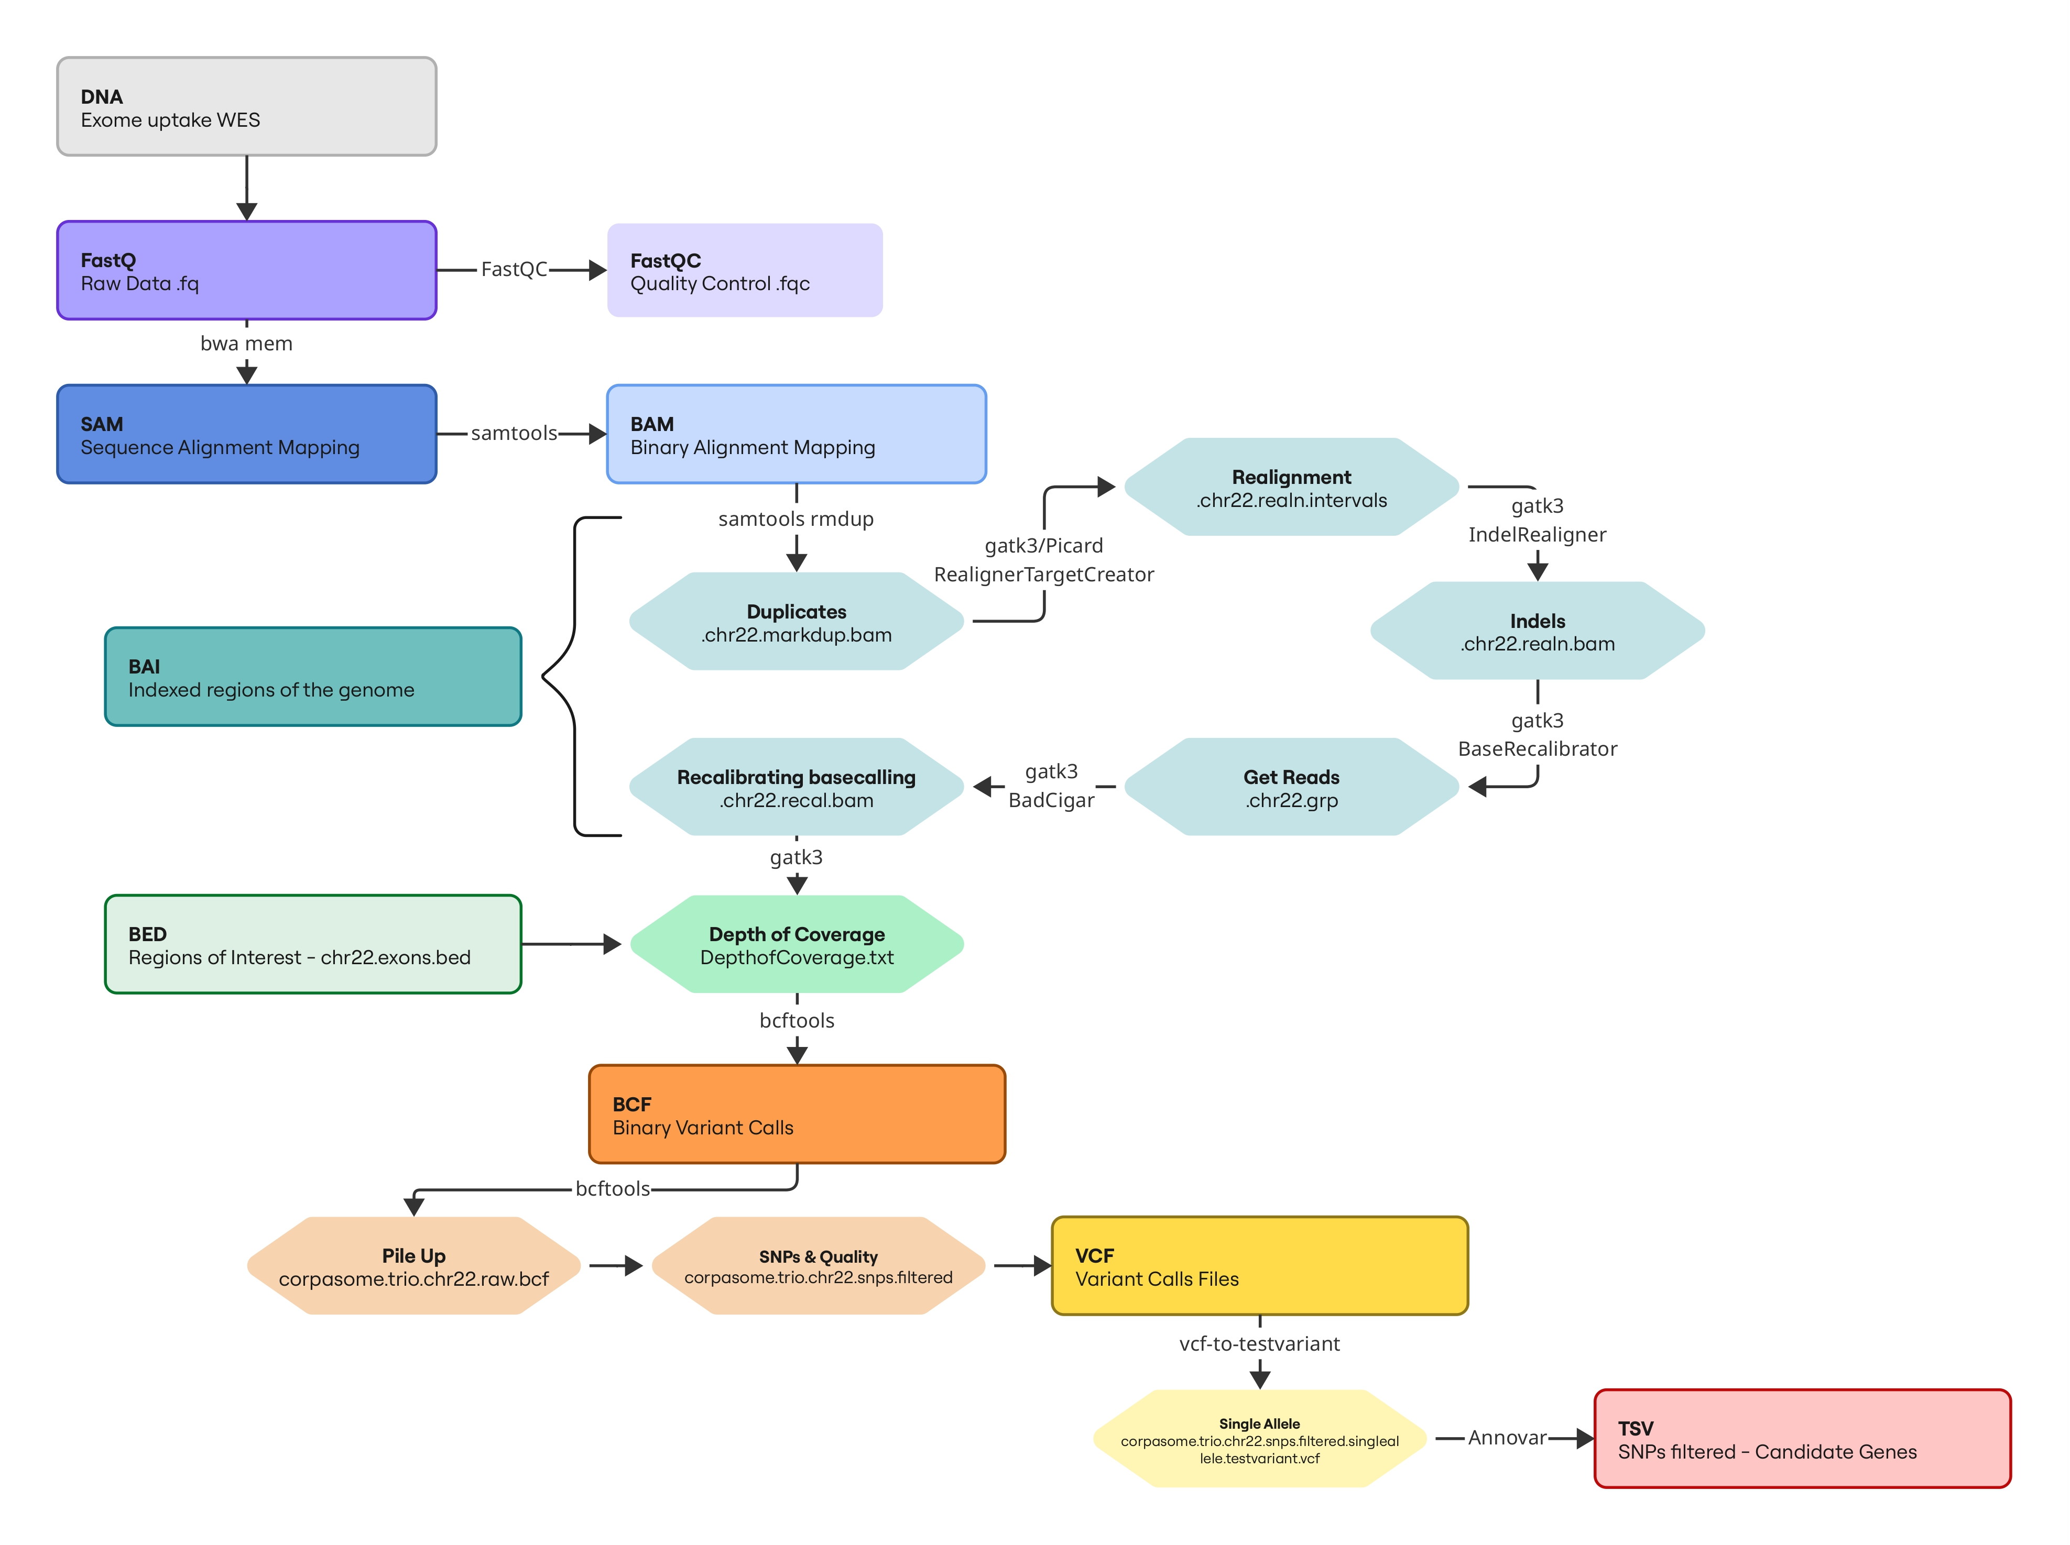
Sample Filtering WorkFlow
hg19
Reference human genome
1000g2012apr_eur, esp6500si_ea
1000 genome project and most common european genes as reference
snp138
Known changes at snp's (dbsnp)
ljb2_pp2hvar (polyphen), ljb2_sift
Important changes in amino acides
clinvar_20140702
Mutations related to diseases
Figure 4: Original figure generated directly from the analysis pipeline code.

Slide 9
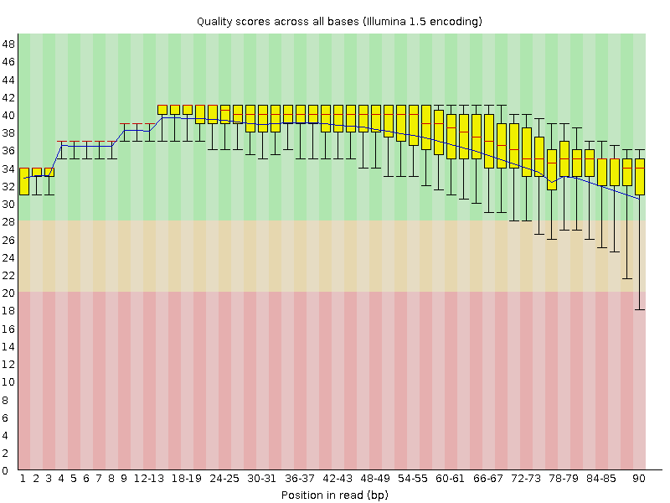
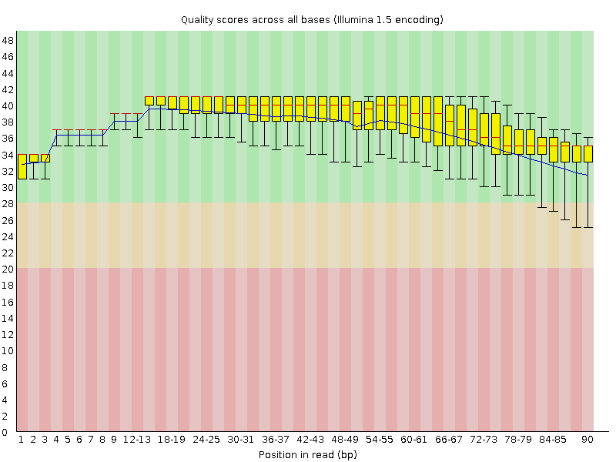
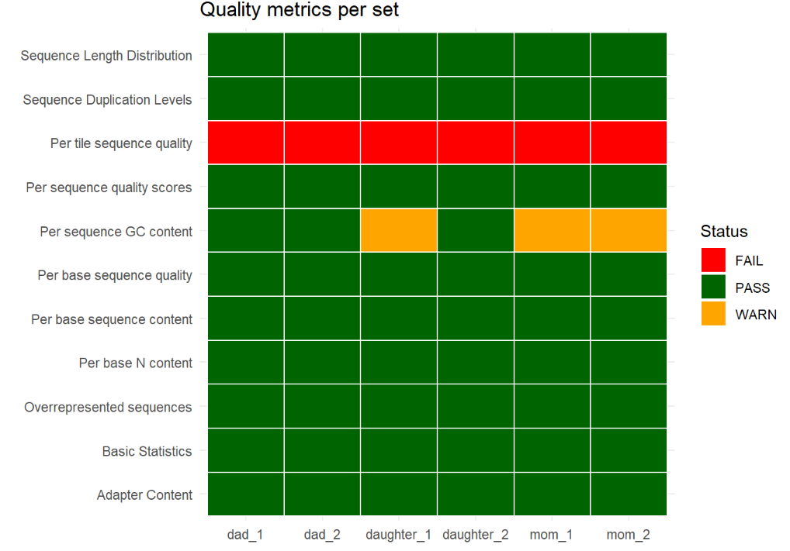
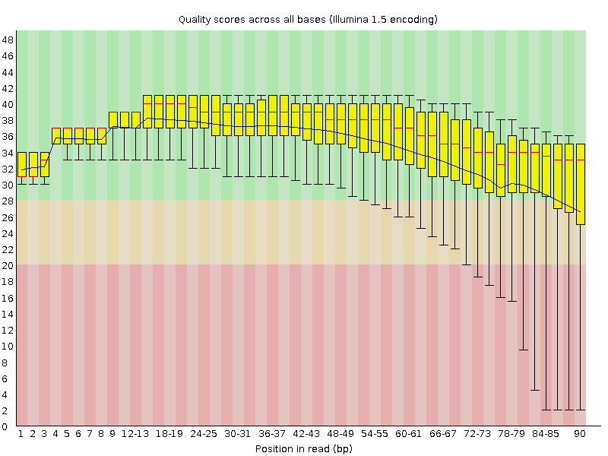
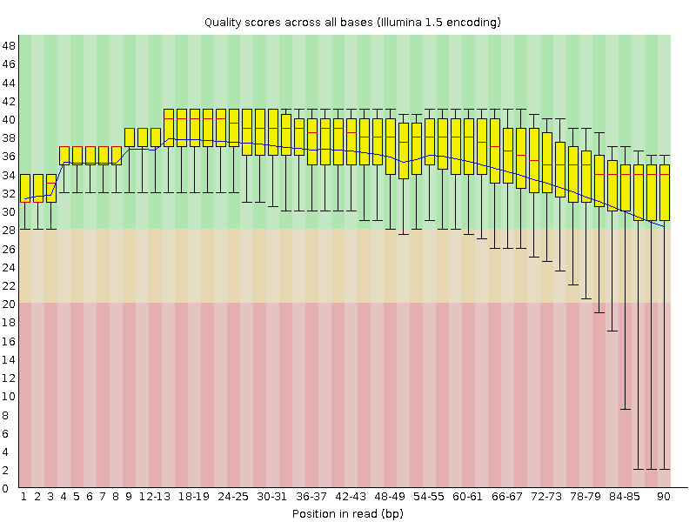

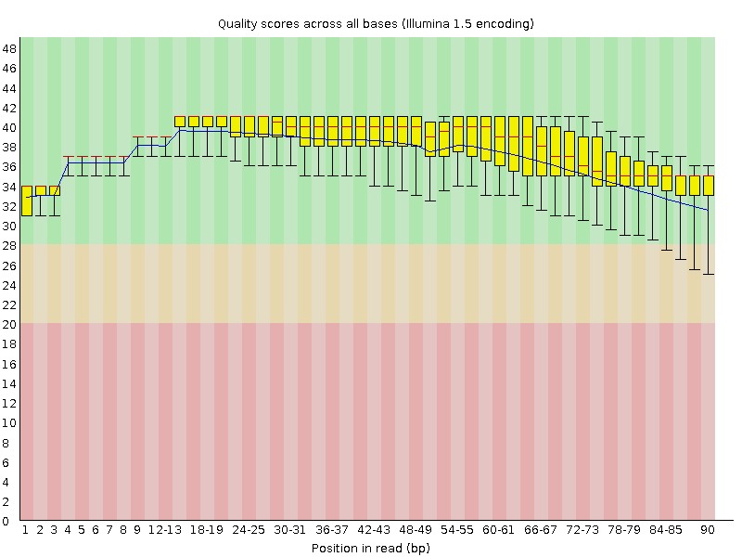
Read 1 (5' -> 3')
Read 2 (5' <- 3')
Quality
Dad
Mom
Daughter
Figure 5: Fast QC analysis provided.
Figure 6: Set quality metrics performed in R.
Notes:
Fast QC, coverage, Flavia

Slide 10
Variant filtering
1
2
3
4
5
Variants
Recessive
Noncommon
Exonic
Deleterious
#Variants | 5983 | 153 | 152 | 37 | 23
#Genes | 298 | 61 | 60 | 17 | 11
01
01
remove variants that are frequent in population databases
corpasome.trio.chr22.snps.filtered.annovar.tsv
Keep variants in exonic regions only
Filter for deleterious variants
11
No disease association | CCT8L2, ZNF280A
Cancer | ATP6V1E1, MED15, RFPL2, XRCC6, NHP2L1, ATP5L2, BRD1, ZBED4
CEDNIK | SNAP29
Varsome
Notes:
Same for denovo, but we know CEDNIK is recessive (still we checked for denovo → no mutation candidate found)
Explain population databases
Explain deleterious

Slide 11
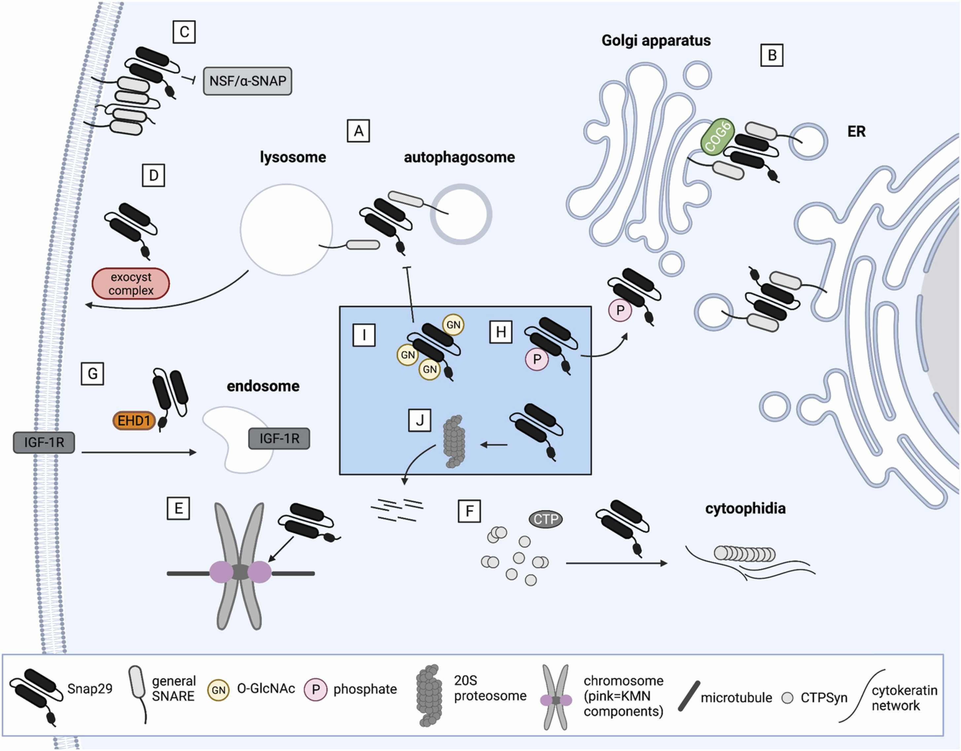
SNAP29
Family of SNARE proteins
Conserved trafficking role
Expressed across all tissues
Morelli et al, 2021
Notes:
Synaptosomal-associated protein 29
Qbc-SNARE (soluble N-ethylmaleimide-sensitive factor attachment protein receptor)
Complex with syntaxin 17 (orange), vesicle associated-membrqane protein 8 (green) → autophagic SNARE complex,
38 SNAREs present in humans (conserved from yeast)
can locate at the plasma membrane, early/recycling endosomes, and other organelles by interacting with other (membrane-anchored) SNAREs
SNAP29 mediates recycling of transferrin and integrins from recycling endosomes (257) and the fusion of these compartments with phagosomes
A SNARE complex requires one R-SNARE and three Q-SNARE motifs, called Qa-, Qb-, and Qc-SNAREs
forming a four α-helical coiled-coil bundle called a cis-SNARE complex. This trans to cis conformation change brings the two opposing fusing membranes in close apposition and provides sufficient energy to drive membrane fusion

Slide 12
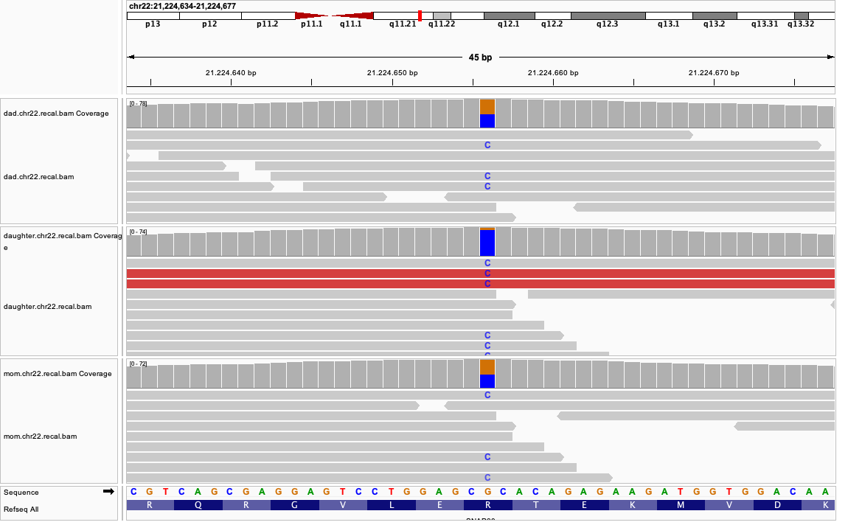
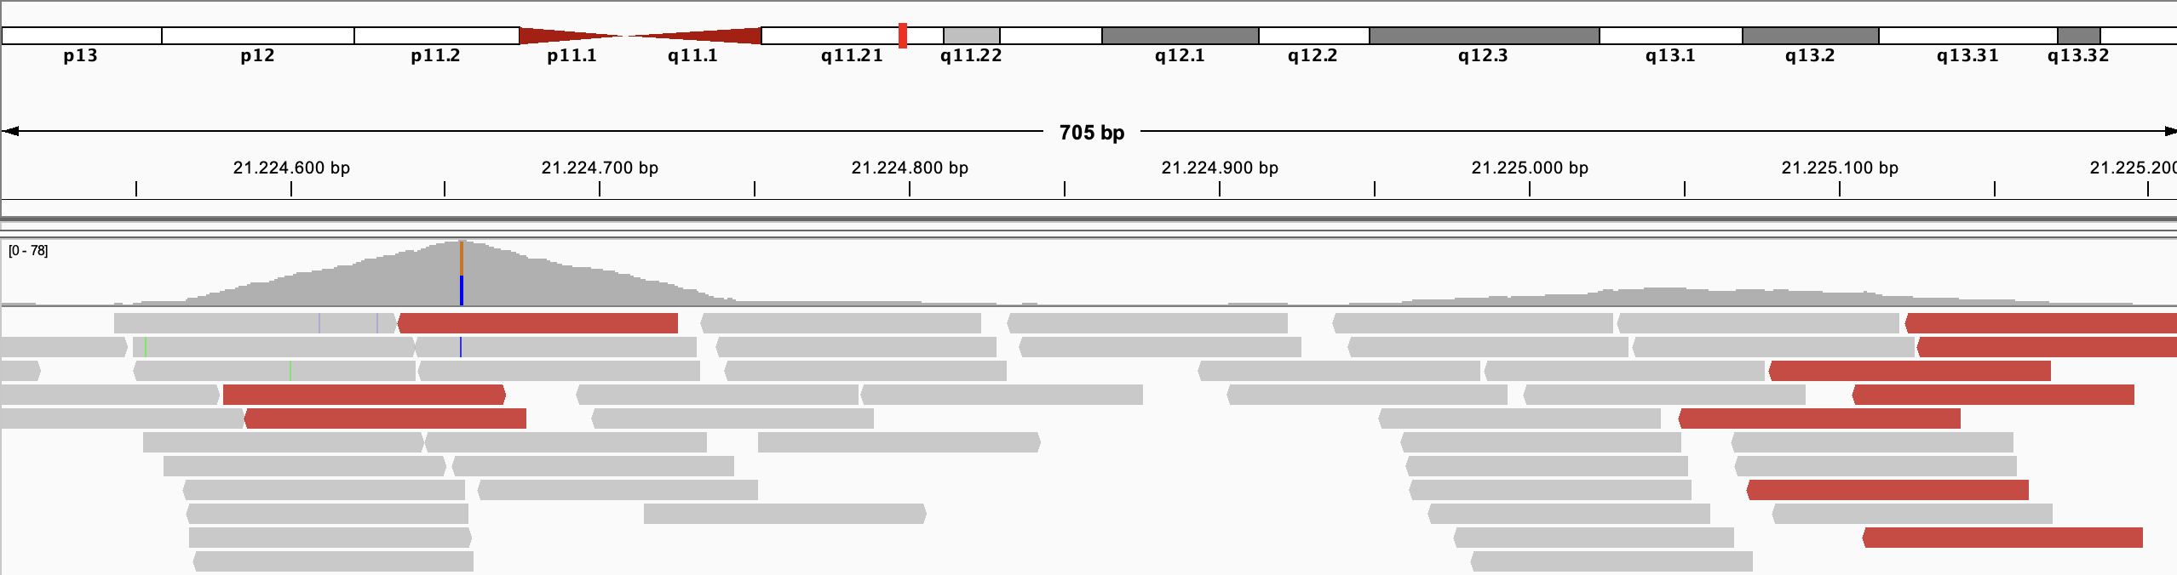
Our candidate variant
chr22:g.21224656G>C
c.269G>C
p.Arg90Pro
01
01
11
IGV version 2.19.8

Slide 13
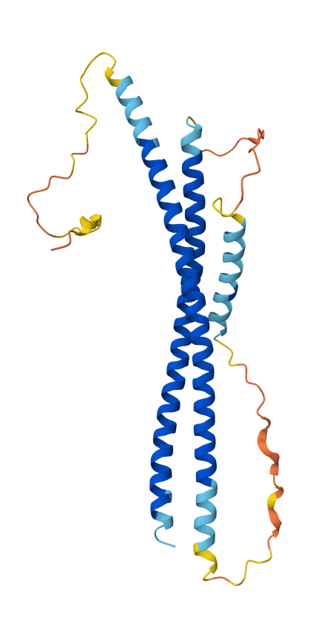
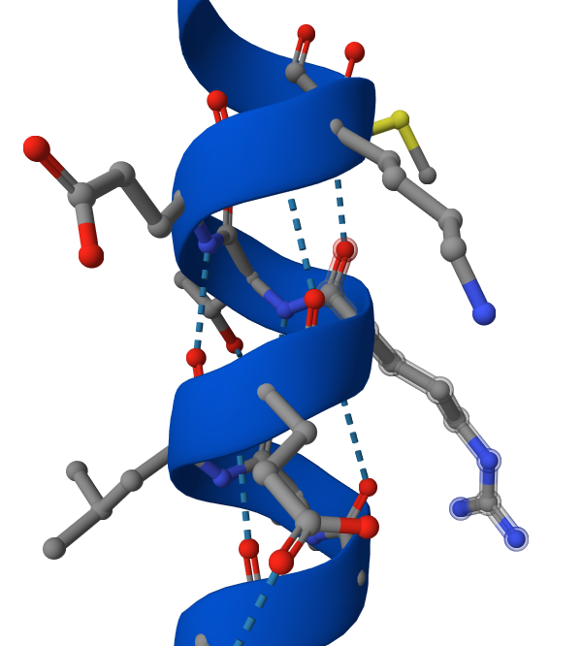
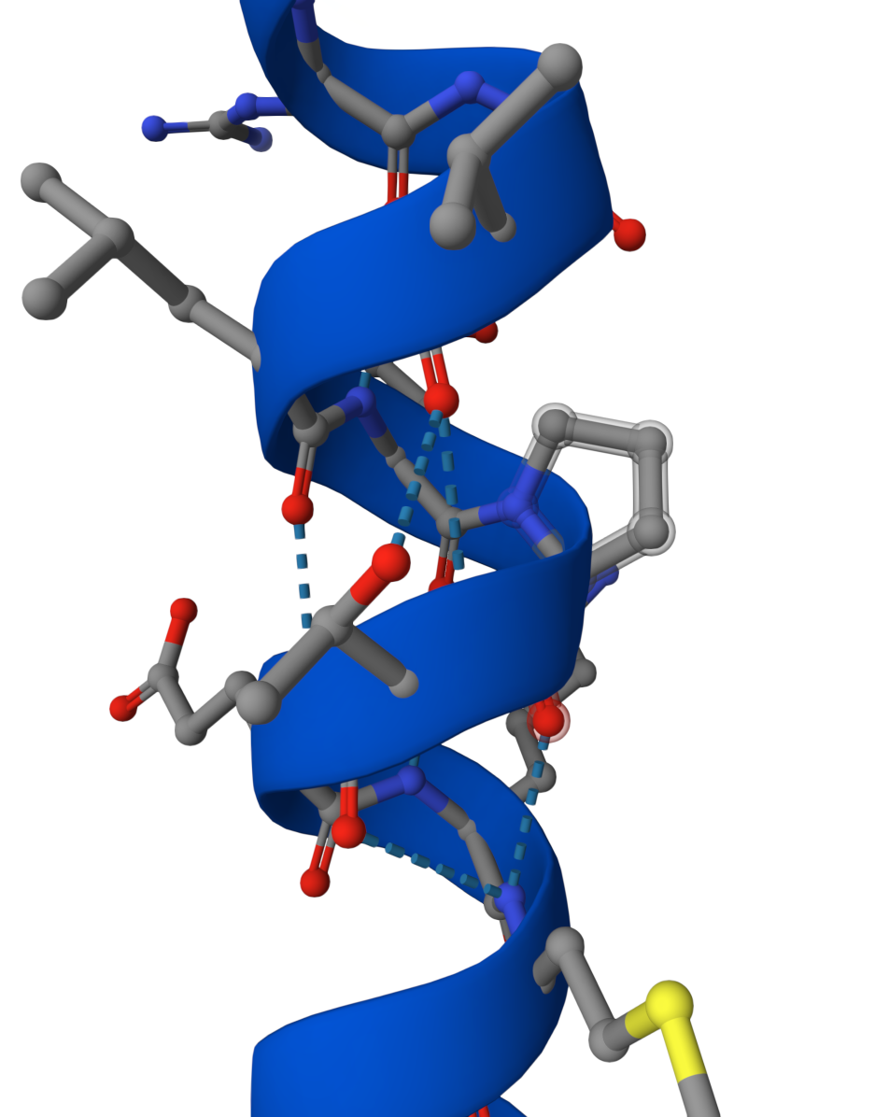
Our candidate variant
Variant positioned in alpha helix of V-Snare motif
Conserved structure
Proline known to break helical structure due to missing NH-group
AlphaMissense prediction: “pathogenic moderate“
Several variants in SNAP29 associated with CEDNIK syndrome
Jumper et al. 2021
cBioPortal v7.1.2
Notes:
Conserved in dog, chicken, zebrafish, PhyloP100Way score: 4.128, PhastCons100way conservation score of 1.000
https://www.ncbi.nlm.nih.gov/clinvar/search/?gene=SNAP29&assembly=GRCh38&disease=CEDNIK
→ Many associated variants in SNAP29

Slide 14
Discussion and Improvements
Database
Reference Databases
WES analysis
Homozygosity
Hg19 as a reference genome instead of hg38
Updated reference genomes. eg hg19 into hg38
Retrieve full genome information using WGS
10% of guanine presenting reads at variant position
Notes:
Not a loss of function variant, not reported yet + 10% G in reads of daughter

Slide 15
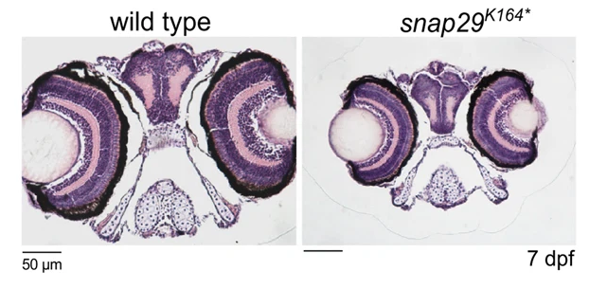
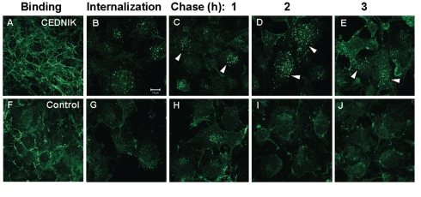
Outlook
Stained sections of zebrafish larvae
Reduction in size of the head in snap29^{K164*} mutant animals
Mastrodonato et al, 2019
Analysis of integrin recycling
Role of integrins in cell migration is essential for epidermal differentiation and brain development
Accumulation of β-integrin in CEDNIK cells
Rapaport et al, 2010
In patient derived and healthy fibroblasts:
Analysis of SNAP29 protein binding using immunoprecipitation
Functional analysis of autophagy (autophagic flux assay)
Notes:
Because the variant is not an obvious loss of function variant and has not yet been reported further analysis is needed to assess the consequences on protein and cellular level
Hematoxylin-eosin stained paraffin sections of heads of 7 dpf larvae
Using fibroblasts and patient derived primary fibroblasts:
A–J) CEDNIK (F110T) and control (SV80) fibroblasts, grown on fibronectin coated plates, were interacted with anti-β1-integrin antibody (binding: A and F). Following internalization (B, G), cells were acid-washed and chased for the indicated times (C–E, H–J). After all the procedures, cells were fixed and immunostained with AlexaFluor 488-conjugated anti-mouse secondary antibody. Arrows indicate accumulation of β1-integrin in enlarged vesicles in CEDNIK cells.
Integrins are transmembrane receptors for components of the extracellular matrix (ECM), which provide a link between the ECM and the cytoskeleton. As a consequence, integrins play a role in transmission of signals to the intracellular milieu [31]and undergo endocytic recycling [32]. Integrins play a major role in cell migration, which is a hallmark of epidermal differentiation [33] and brain development
Extend to neurons with artifical introduction of the variant (→ analyse spindle formation and mitosis)

Slide 16
References
General Information:
M. Corpas et al., "Crowdsourced direct-to-consumer genomic analysis of a family quartet," BMC Genomics, vol. 16, p. 910, Nov. 2015, doi: 10.1186/s12864-015-1973-7.
X. Liu, C. Wu, C. Li, and E. Boerwinkle, "dbNSFP v3.0: A One-Stop Database of Functional Predictions and Annotations for Human Non-synonymous and Splice Site SNVs," Human Mutation, vol. 37, no. 3, pp. 235–241, Mar. 2016, doi: 10.1002/humu.22932.
Cerami, Ethan, Jianjiong Gao, Ugur Dogrusoz, et al. 2012. ‘The cBio Cancer Genomics Portal: An Open Platform for Exploring Multidimensional Cancer Genomics Data’. Cancer Discovery 2 (5): 401–4. https://doi.org/10.1158/2159-8290.CD-12-0095.
De Bruijn, Ino, Ritika Kundra, Brooke Mastrogiacomo, et al. 2023. ‘Analysis and Visualization of Longitudinal Genomic and Clinical Data from the AACR Project GENIE Biopharma Collaborative in cBioPortal’. Cancer Research 83 (23): 3861–67. https://doi.org/10.1158/0008-5472.CAN-23-0816.
Dingjan, Ilse, Peter T. A. Linders, Danielle R. J. Verboogen, Natalia H. Revelo, Martin Ter Beest, and Geert Van Den Bogaart. 2018. ‘Endosomal and Phagosomal SNAREs’. Physiological Reviews 98 (3): 1465–92. https://doi.org/10.1152/physrev.00037.2017.
Gao, Jianjiong, Bülent Arman Aksoy, Ugur Dogrusoz, et al. 2013. ‘Integrative Analysis of Complex Cancer Genomics and Clinical Profiles Using the cBioPortal’. Science Signaling 6 (269). https://doi.org/10.1126/scisignal.2004088.
Jumper, John, Richard Evans, Alexander Pritzel, et al. 2021. ‘Highly Accurate Protein Structure Prediction with AlphaFold’. Nature 596 (7873): 583–89. https://doi.org/10.1038/s41586-021-03819-2.
Mastrodonato, Valeria, Galina Beznoussenko, Alexandre Mironov, Laura Ferrari, Gianluca Deflorian, and Thomas Vaccari. 2019. ‘A Genetic Model of CEDNIK Syndrome in Zebrafish Highlights the Role of the SNARE Protein Snap29 in Neuromotor and Epidermal Development’. Scientific Reports 9 (1): 1211. https://doi.org/10.1038/s41598-018-37780-4.
Morelli, Elena, Elisa A. Speranza, Enrica Pellegrino, et al. 2021. ‘Activity of the SNARE Protein SNAP29 at the Endoplasmic Reticulum and Golgi Apparatus’. Frontiers in Cell and Developmental Biology 9 (February): 637565. https://doi.org/10.3389/fcell.2021.637565.
Rapaport, Debora, Yevgenia Lugassy, Eli Sprecher, and Mia Horowitz. 2010. ‘Loss of SNAP29 Impairs Endocytic Recycling and Cell Motility’. PLoS ONE 5 (3): e9759. https://doi.org/10.1371/journal.pone.0009759.
Smeele, Paulien H., and Thomas Vaccari. 2023. ‘Snapshots from within the Cell: Novel Trafficking and Non Trafficking Functions of Snap29 during Tissue Morphogenesis’. Seminars in Cell & Developmental Biology 133 (January): 42–52. https://doi.org/10.1016/j.semcdb.2022.02.024.
Zhao, M., and A. T. Brunger. 2015. ‘Crystal Structure of Autophagic SNARE Complex: 4wy4’. February 11. https://doi.org/10.2210/pdb4wy4/pdb.

Slide 17
References
Tools and Programs:
J. T. Robinson et al., "Integrative Genomics Viewer," Nature Biotechnology, vol. 29, no. 1, pp. 24–26, Jan. 2011, doi: 10.1038/nbt.1754. IGV version 2.19.8
E. Cerami et al., "The cBio Cancer Genomics Portal: An Open Source Platform for Exploring Multidimensional Cancer Genomics Data," Cancer Research, vol. 72, no. 21, pp. 5602–56011, Nov. 2012, doi: 10.1158/0008-5472.CAN-12-0950. cBioPortal v7.1.2
Figures and Graphs:
Figure 1: Lorenzo-Ríos D, Guerrero-García A, Colón-Fontánez F. Keratoderma and ichthyosis as valuable features for the diagnosis of CEDNIK syndrome JAAD Case Reports, 2023; 46, 64-66
Figure 2: A. Y. Mah-Som et al., "New Cohort of Patients With CEDNIK Syndrome Expands the Phenotypic and Genotypic Spectra," Neurology: Genetics, vol. 7, no. 1, p. e553, Feb. 2021, doi: 10.1212/NXG.0000000000000553
Schiller, S. A., Seebode, C., Wieser, G. L., Goebbels, S., Möbius, W., Horowitz, M., ... & Emmert, S. (2016). Establishment of two mouse models for CEDNIK syndrome reveals the pivotal role of SNAP29 in epidermal differentiation. Journal of Investigative Dermatology, 136(3), 672-679.

Slide 18
Genomics and Databases – IMBM5
Thank
You

